Slide 1



Monetize Your Art
Delievered in partnership with

Slide 2

First, some review…
What are your SMART goals?

Slide 3
PITCH

Slide 4
Pitch Day!
Saturday June 20, 12pm
4 minute pitch presentation
6 minute Q&A
$500 Grant for 3 participants
Notes:
TRANSITION: So those are the prizes and awards we’re giving out. But I have a question for you now. What exactly is a pitch?

Slide 5
WHAT IS A PITCH?
An opportunity to invite investment
  In you
  In your business
  In where you’re going
People invest in stories.
Notes:
TRANSITION: Sometimes we think we’re telling a story, but the story only works if the specific audience you’re telling it to understand it. I’ll give you an example. It may shock you to learn that “THIS IS NOT BREAD”.

Slide 6
Before we begin
There’s a difference in pitching for yourself vs for others.
Avoid making yourself feel good.
Focus on making others UNDERSTAND
“Does THIS audience understand what I actually do and why it’s important?”
Notes:
Remember to always tell the story so that the audience in front of you actually understands it. This audience will be a group of people that don’t know you and are trying to understand what you’re all about right away.
TRANSITION: We’ve actually prepared a template for you to help tell that story…

Slide 7
What’s the difference?
Pitch A
  “We empower individuals to get inspired by technology and collect items for their life that are typically very costly, on a millennial budget ”
Pitch B
  “Our mobile and web app provides tech enthusiasts on a budget with a streamlined and easy to use marketplace where they can buy second-hand gadgets ready for a new life”
Notes:
Ask the audience what their thoughts are on the difference between these two pitches.
The correct answer is that Pitch B is much better because it is being done with the intent to make the audience understand. It’s for THEM. Not you.

Slide 8
Pitch Structure:

Slide 9
The Introduction
Who are you?
Tell the audience something important about yourself
Mention what kind of artist you are and what kind of art your business creates
Surface level sh*t
(10 secs)
Notes:
This is a good time to begin painting the picture of the problem you are trying to solve.

Slide 10
The Problem
What problem are you solving with your art?
Who has this problem?
Provide evidence that this problem exists (use market research)
(75 sec)
Notes:
This is your chance to talk about why your product is important,

Slide 11
The Solution
How is your art a solution to this problem?
Make your value proposition clear
How do you know the customer is interested in your solution?
Provide evidence of traction
(30 secs)
Notes:
This is your chance to talk about why your product is important,

Slide 12
What’s your Plan?
What are you working towards?
What are your SMART goals?
What are you trying to validate?
What’s your MVP?
(60 secs)
Notes:
This is your chance to talk about why your product is important,

Slide 13
What are you asking for?
What do you need to make your goal a reality and how much will it cost?
What are your total start-up costs?
How would you use the $500 grant?
Make a case for why you NEED the money!
(55 secs)
Notes:
Imagine it was your money someone was asking for!!!!

Slide 14
The Conclusion
Wrap up the story and any other loose ends
Thank the panel and audience for their attention
Invite questions and comments
(10 secs)
Notes:
End on a strong note and conclude by brining it back to your story if possible

Slide 15
Pitching Tips
Speak with confidence
  Confidence comes with practice!
Practice, practice, and practice
Embody your brand; dress, body language, and tone

Slide 16
My Secret Sauce
Record your audio when practicing and use it as a shortcut around rehearsing endlessly
Practice the art of seamless transitions for a well flowing presentation
Have a “secret slide” after your “thank you” slide that addresses a common question
Notes:
]

Slide 17
Other top secrets
Use a cloud based presentation-software
  Beautiful.ai; Google Slides; Slide Bean
Don’t be afraid of using templates (Canva <3)
Know your story without your slides
Notes:
]

Slide 18

EXAMPLE PITCH

Slide 19

Notes:
Hi. My name is Melissa Falconer, also known as M.Falconer
I’m a visual artist from Toronto. I’ve been painting for 6 years

Slide 20
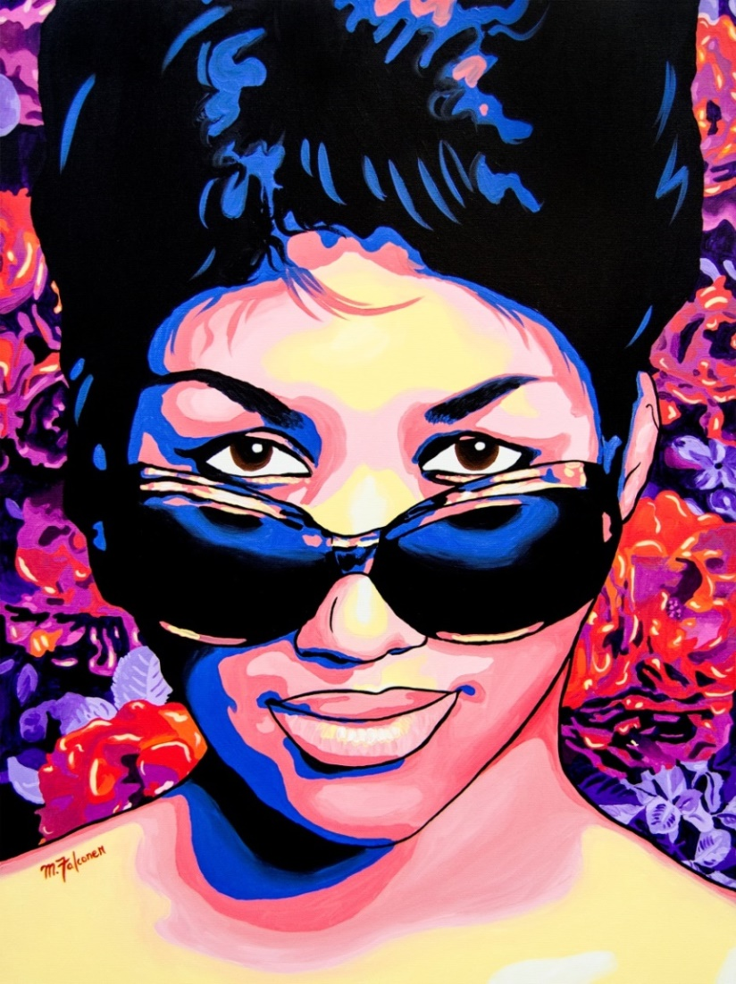
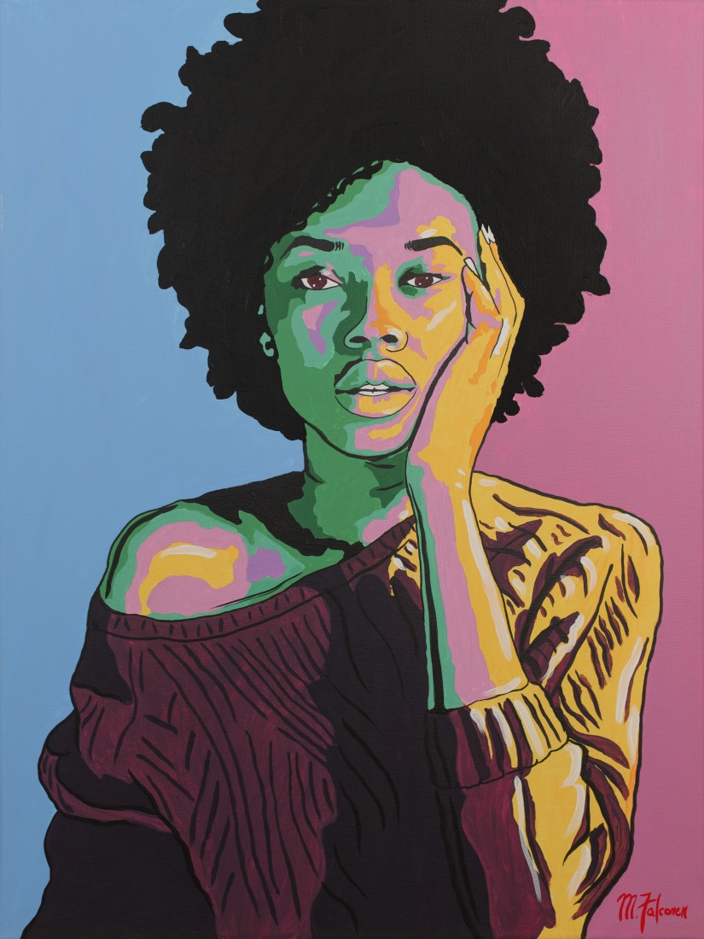
Notes:
And I make pop art paintings inspired by Black culture

Slide 21
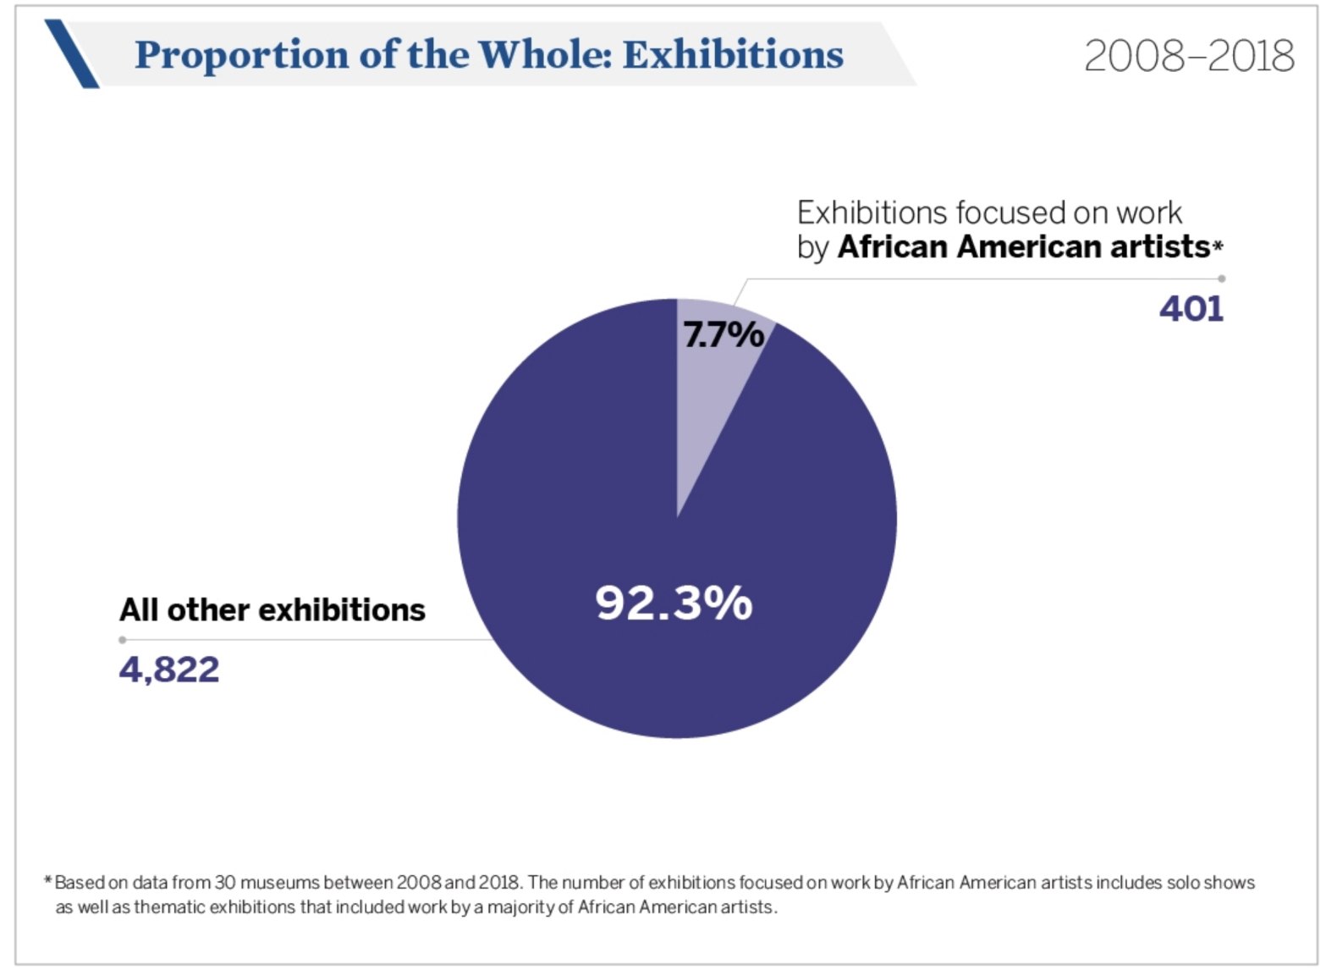
Source: https://news.artnet.com/market/african-american-research-museums-1350362
Notes:
The art industry is huge, grossing $64 billion annually. Considering the size of the art industry, it may be surprising to find that there is an overwhelming lack of diversity. Just like in the media, minorities are historically underreprsented in the arts. For example, out of all the art exhibits in the USA between 2008-2018, only 7% of exhibits in museums are dedicated to the work of African American artists

Slide 22
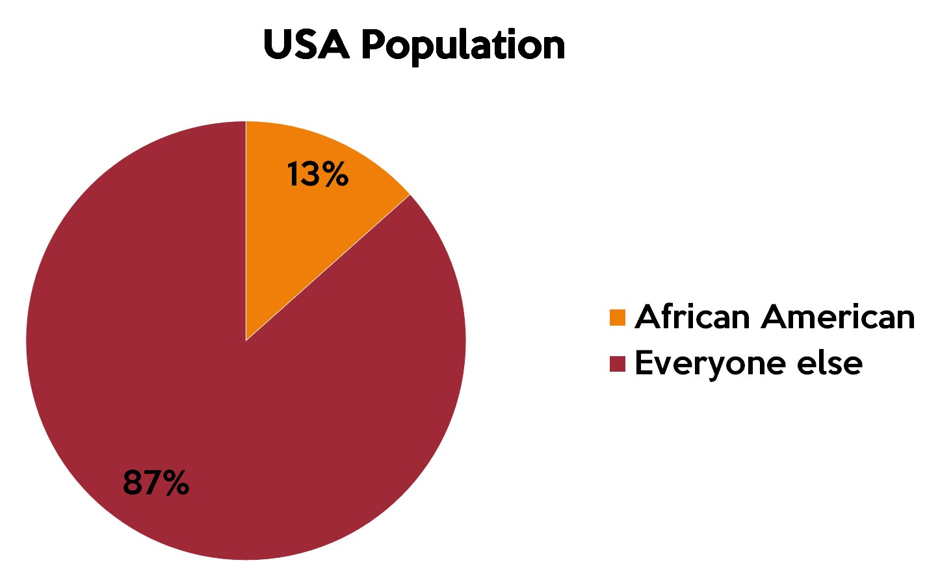
Source: https://www.census.gov/quickfacts/fact/table/US/PST045219
Notes:
This is a problem because African Americans represent 13% of the US population

Slide 23

Black Art Consumers
Young Black people
Pains:
  Finding art that represents them
  Discrimination
  Underrepresentation
Goals:
  To be comfortable in their own skin
  To support other Black businesses
Values:
  Empowerment
  Self-love
  Community
  Representation
Notes:
Therefore Black consumers looking for artwork have a hard time finding artists that make them feel represented, feel empowered, find self-love, and build community.

Slide 24
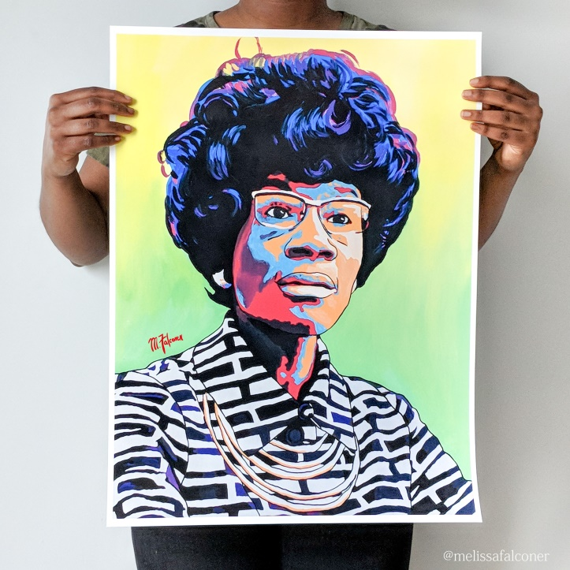
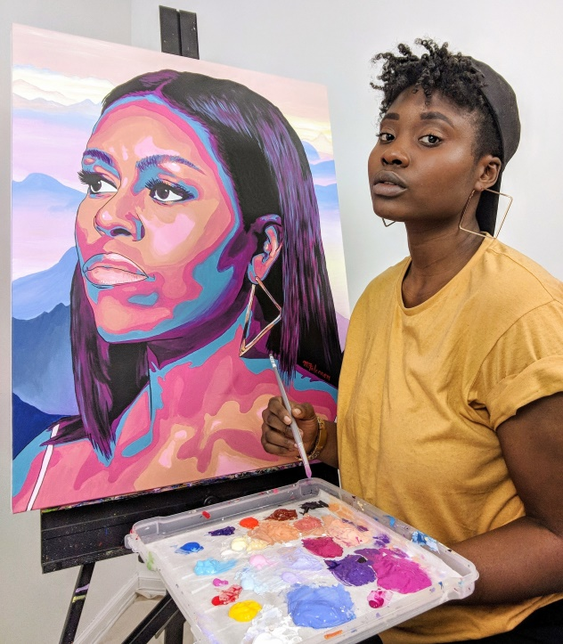
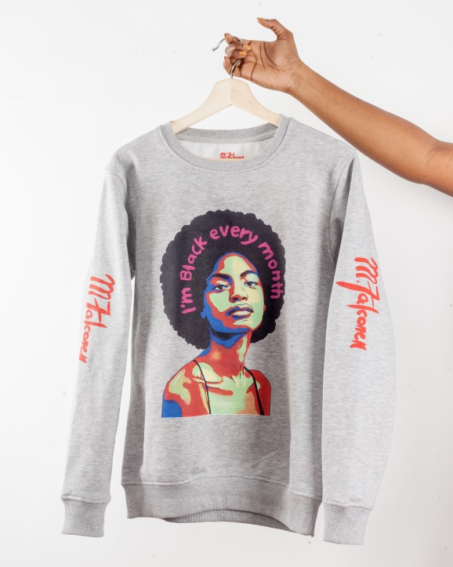
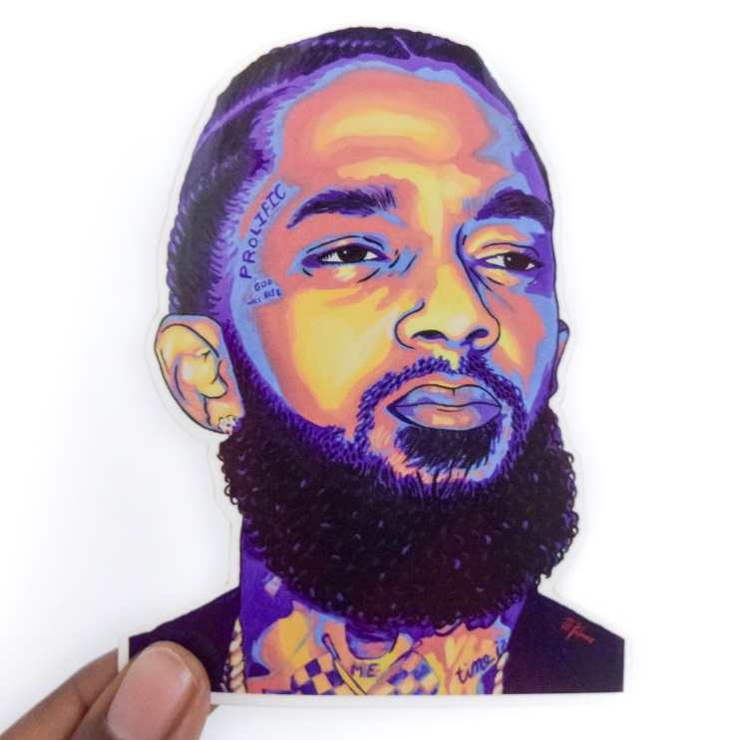
Prints
Paintings
Apparel
Stickers
Notes:
That’s why I created M.Falconer! I create art and art products that represent Black culture so that Black people can have an authentic source from which to express themselves.

Slide 25
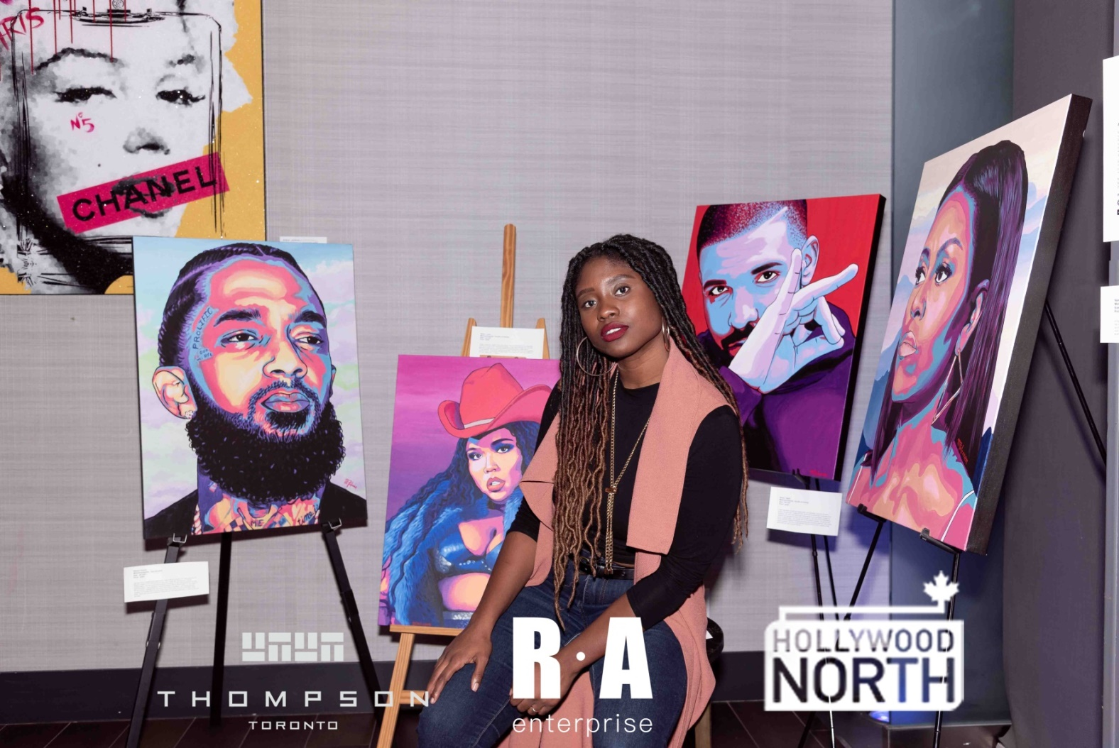
Featured in:
The AGO
Blavity
The Shaderoom
HuffPost
CBC
TIFF
Notes:
So far, I’ve been featured as a Black artist in places like the AGO, Blavity, The Shaderoom, Huffpost, CBC and Tiff

Slide 26
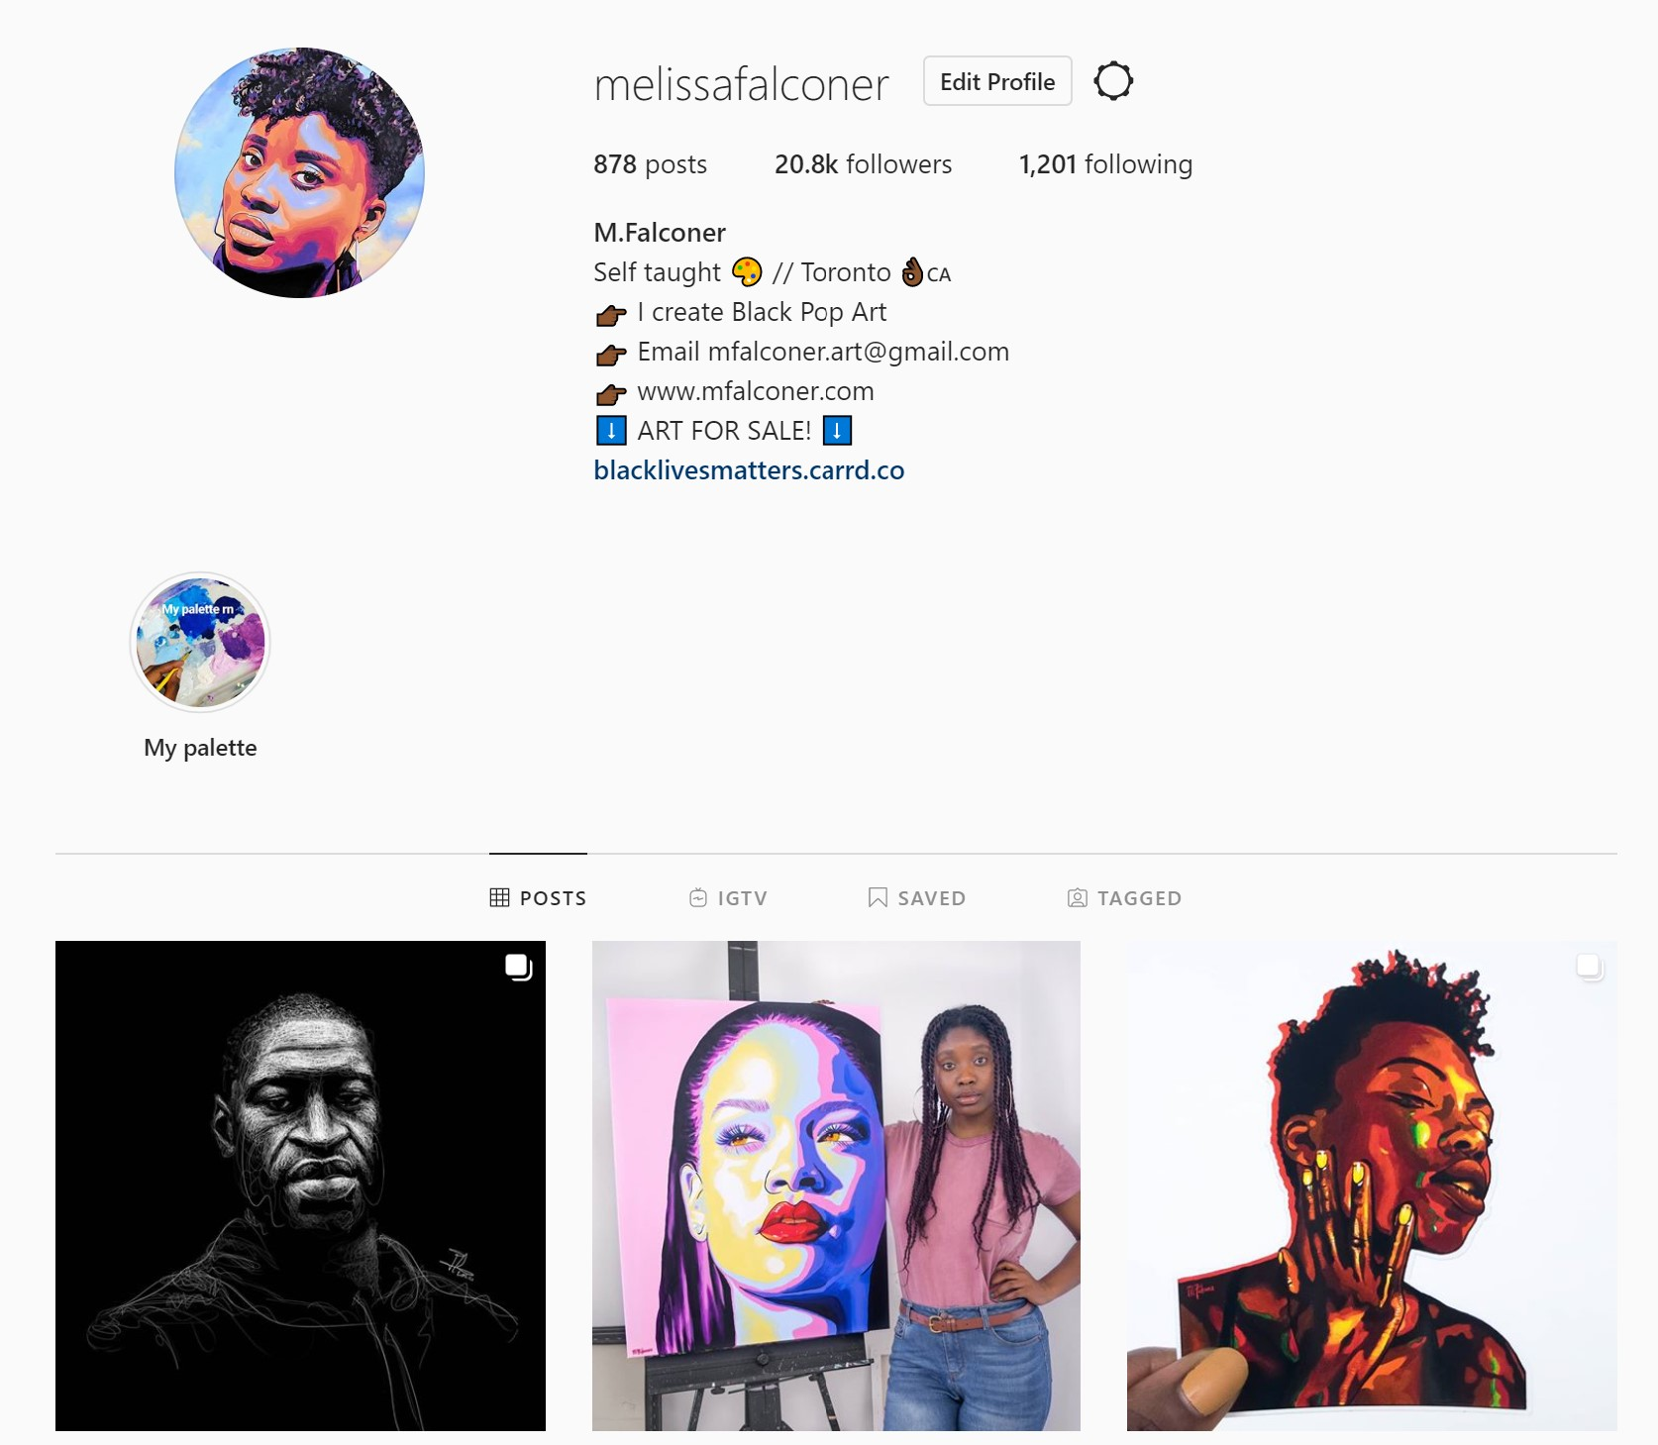
Built and audience of over 20k followers on Instagram
Notes:
I’ve gained over 20k dedicated followers on Instagram

Slide 27
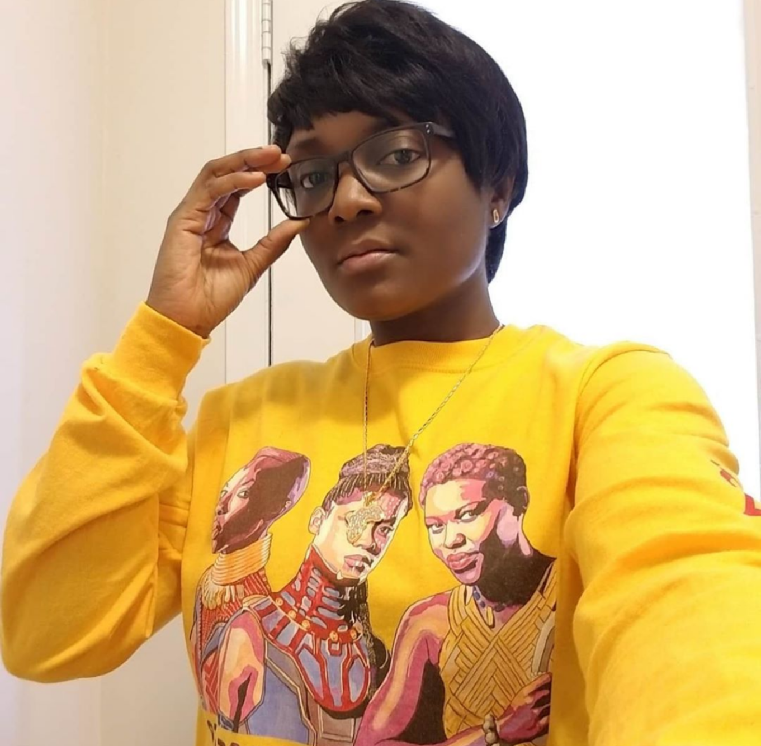
Customer Feedback
“I feel proud to wear M.Falconer apparel because she paints people who I identify with”
- Tobi
Notes:
And tons of feedback from fans who say

Slide 28
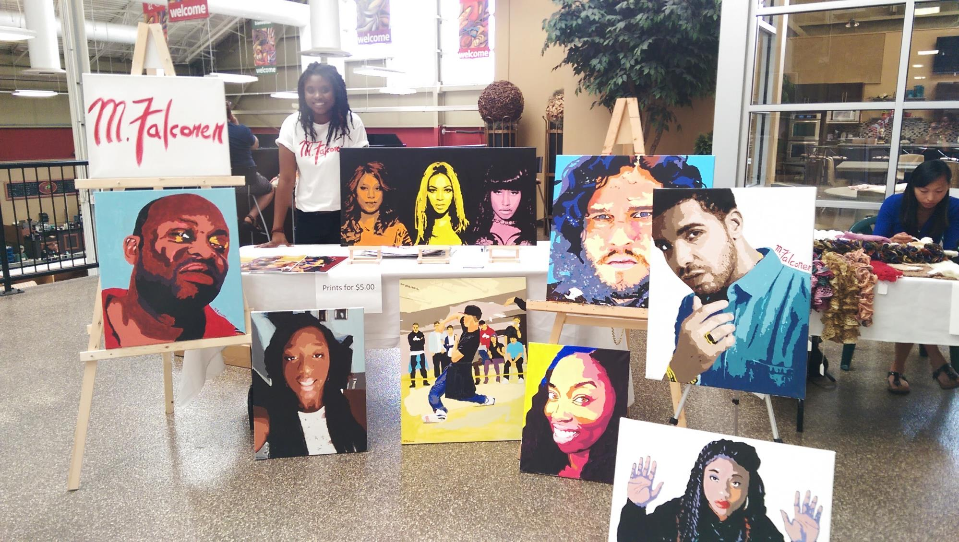
Notes:
To date, I’ve only been selling my work on social media, and at local markets. This has been great but now it’s time to take my business to the next level

Slide 29
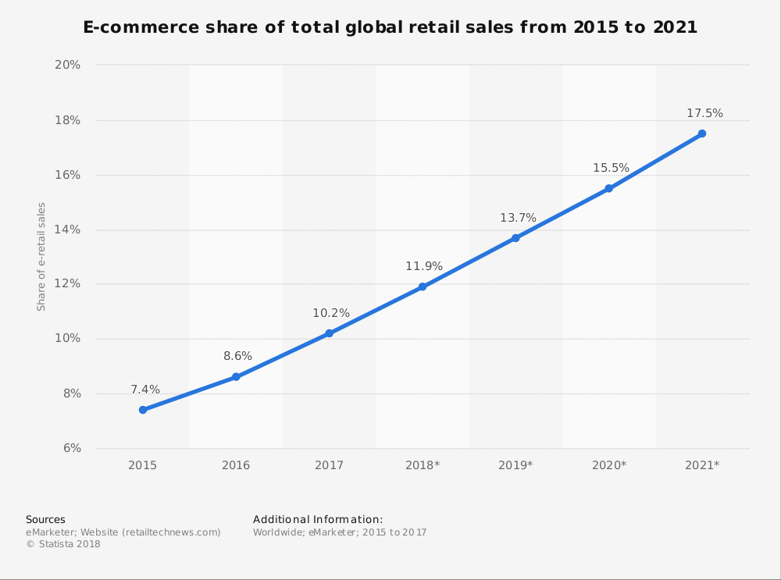

Goal:
Create my own e-commerce website using Squarespace within 3 months in order to start generating online sales
E-commerce is where it’s at
Notes:
My goal is to create my own website using Squarespace within 3 months
It’ no secret that e-commerce growing to become one of the best ways to sell products. More and more consumers are turning to online shopping because it’s more convenient. By bringing my business online I’ll be able to reach more customers, faster than traditional retail and reach larger markets worldwide because I’ll be able to sell in countries like the US and the UK.
I’ve decided to use Squarespace because it’s one of the largest web hosting platforms available, it’s features are designed specifically for artists with beautiful templates that I can use to showcase my art and they have integrated e-commerce features like email marketing, sales pop-ups and scarcity tactis.

Slide 30
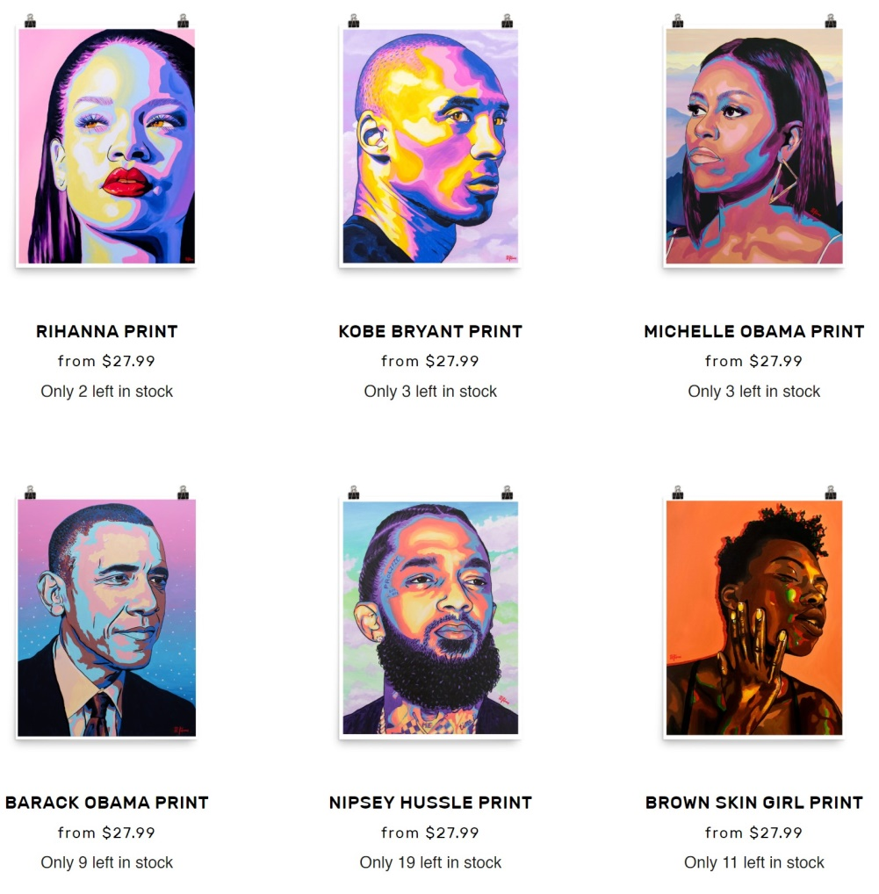
Goal:
Create my own e-commerce website using Squarespace within 3 months in order to start generating online sales
www.mfalconer.com
Notes:
My website will be called www.mfalconer.com and I will start by selling a collection of my art prints. Prices will start at $27.99 and I will be shipping to Canada and the US. The purpose is to validate that I can sell products online to multiple countries. This will be the foundation of my growth moving forward because having my own website is important for establishing a brand that consumers can trust.

Slide 31
Startup Costs
Domain name (1 year) | $20
Website hosting (1 year) | $200
Initial inventory | $150
Shipping Supplies | $75
Product photography | $100
Total | $545
Notes:
In order to get my website up and running I’ll need…

Slide 32
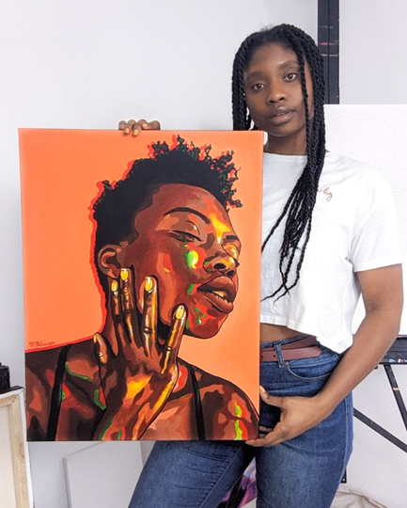

Notes:
In conclusion, help me turn my dream into a reality by bringing M.Falconer online and helping to make Black art accessible to the people who need it most. Thank you.

Slide 33
It’s your turn!

Slide 34
ACTIVITY 1:
YOUR PITCH

Slide 35
THANK YOU FOR THE GREAT COHORT!

